Slide 1
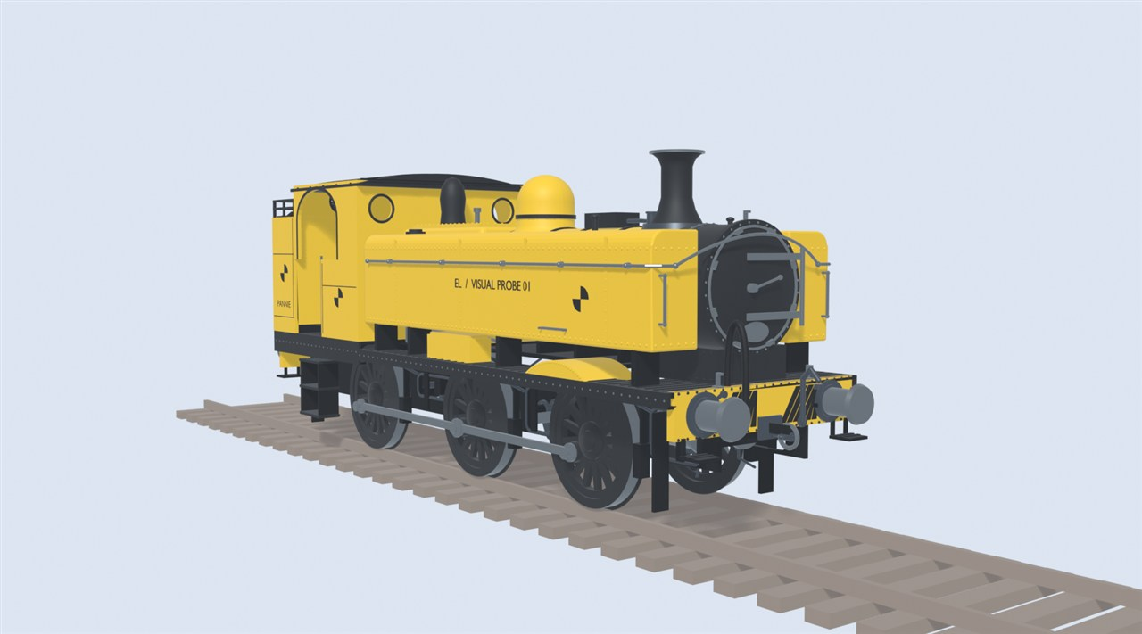
Regions, Running Numbers and Fleet Identity
How the mod gives every engine a look, a number and a hidden identity.
Early Locomotion project render. Early test model, not final art.

Slide 2
How to read this guide
AGREED
Decided.
PROPOSED
Suggested, not confirmed.
PROVISIONAL
A test number that may change.
UNDECIDED
Still an open question.
BACKGROUND
A real-world fact.
Every idea carries a tag in the top-right corner.
2

Slide 3
One world, one style
AGREED
World style
British
North American
Continental European
Examples only
Launch regions: undecided (OQ06)
The world picks one regional style. It is not a personal setting.
3

Slide 4
Why not per player?
AGREED
Player 1
Player 2
One shared world style
Two players seeing different stations would be confusing. So the style belongs to the world.
4

Slide 5
What changes with the region
AGREED
Station
Engine
Wagon
Before
After
Not yet tested
Changing the region restyles stock you already own, not just new builds.
5

Slide 6
Three sizes, many looks
AGREED
Examples only
British
North American
Continental European
Small
Medium
Large
Every style gets a Small, a Medium and a Large. Each engine looks and behaves in its own way.
6

Slide 7
Different engines, same rules
AGREED
Own data card
Own data card
Own data card
Shared rules
The code is shared. The engines are not. Each model keeps its own wheels and shape.
7

Slide 8
Weight and power differ
AGREED
Heavy engine, heavy wagons
More power
Lighter engine, light wagons
Less power
Illustration only. No values chosen.
Regions differ in weight and power. The aim is trains that are about equally useful.
8

Slide 9
A consist follows its lead engine
AGREED
Lead engine
British style
Lead engine
North American style
Lone wagon
World style
Wagons take the look of the engine pulling them. A lone wagon follows the world style.
9

Slide 10
Which engine leads?
UNDECIDED
?
?
OQ06, OQ27
With two engines, which one leads? That is not settled.
10

Slide 11
When the region changes
UNDECIDED
Do weight and power change?
What about trains on the move?
?
?
What happens on load?
How is train weight shown?
?
?
OQ06
What happens to engines already running when the region changes? Not decided.
11

Slide 12
A hidden identity
AGREED
Fleet ID: hidden
No. 1234
Where it is stored: undecided (OQ28)
Example only
Repaint
Change region
Fleet ID
Fleet ID
Renumber
Every engine has a hidden permanent ID. Its visible number can change.
12

Slide 13
A number after placement
AGREED
1
Hologram: no number
2
Placed
3
Number appears
No. 1234
Example only
Normal engines are class members and carry no personal names.
Your engine gets its number once it is placed.
13

Slide 14
Numbers survive region changes
AGREED
British
North American
British
No. 1111
No. 2222
No. 1111
British
British
North American
British
No. 1111
You edit
No. 3333
No. 2222
No. 3333
Example only
Switch region and back, and your engine gets its old number back. A number you changed stays changed.
14

Slide 15
Two numbering styles
AGREED
Standardised
Historical Operator
One consistent scheme
Rules like the old railway companies
Exact data: undecided (OQ29)
The world picks how numbers look: simple and consistent, or like the old operators'.
15

Slide 16
Changing the style
AGREED
Example only
47
298
Switch style
31
298
Set by the scheme
Your digits
Changes
Stays
Switching style keeps the digits you chose, where they still fit.
16

Slide 17
No two the same
AGREED
Taken?
Make a candidate number
Reserve it
No
Yes
Which pool: undecided (OQ29)
Two engines cannot share a number. The game retries until it finds a free one.
17

Slide 18
Reuse and overflow
AGREED
Dismantled
Pool full
X-00001
Overflow
Example only
Number pool
Format: undecided
A dismantled engine's number goes back to the pool. If a pool is full, a clearly modern number is used.
18

Slide 19
Renumber by hand
AGREED
Renumber unlock
Edit number
Example only
47
298
Already used
Unlock
Cost and screens: undecided (OQ30)
A cheap unlock lets you edit your numbers. Locked parts stay locked.
19

Slide 20
Numbers in the right place
AGREED
Agreed direction
Tender
Cab side
Front of the boiler
Bunker
Tank side
Each engine shows its number where real ones did. There is no single decal spot.
20

Slide 21
Find any engine
AGREED
Agreed direction
9F
Class
92214
Number
Matches only
Example only
Screens: undecided (OQ30)
Type a number or a class. Matches stand out on the map.
21

Slide 22
Researched, not copied
AGREED
Not reused
British
North American
Continental European
Own rules
Own rules
Own rules
Each region's numbering is researched on its own. British rules are not reused elsewhere.
22

Slide 23
A note on the build card
PROPOSED
Numbering note (example only)
PROPOSED
A build card could show a short note on how the class was numbered.
23

Slide 24
Where this stands
PROVISIONAL
Plans can change.
Early test model, not final art.
Test engine on the game's rails
Regional styles
Running numbers
Fleet search
Under way
Planned
Planned
Planned
Regions and numbering are planned. They are not built yet.
24

Slide 25
Still undecided
UNDECIDED
UNDECIDED · OQ06
UNDECIDED · OQ06, OQ27
UNDECIDED · OQ06
UNDECIDED · OQ28
Which regions at launch?
Which engine leads?
Running trains after a switch
Where IDs are stored
UNDECIDED · OQ29
UNDECIDED · OQ29
UNDECIDED · OQ30
UNDECIDED · OQ30
Number pools and data
Overflow number format
Renumber cost and screens
Search and filter screens
These questions are open. Nothing here has been chosen yet.
25

Slide 26
Image credits
Slot | Slides | What it shows | Credit
R01 | 1, 24 | Early test model of a tank engine (a yellow 'visual probe') on a short length of track. Not final art. | Early Locomotion project (test model, not final art).
Engine, wagon and station drawings in this deck are generic example silhouettes made from shapes. They are not the mod's models.
This deck uses no photographs.
26

